Slide 1

Customer Analytics
Introduction Lecture
Notes:
George Knox not present due to personal reasons, I will cover the introduction lecuture today and my collegue Gijs will cover the computer lab session next Thursday
From next week onwards, he will teach the lectures, computer lab sessions and Q&A lectures

Slide 2
Agenda
House rules & Introduction of the team
Introduction Customer Analytics
General Course Information
Web clips Module 1

Slide 3
1. House rules & Introduction of the team

Slide 4
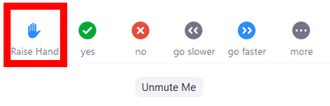
House Rules
Keep your microphone muted when you don’t speak
Keep your camera on for the lectures
If you would like to speak, raise your hand with the Raise Hand function and wait to be called on
Or
Use the chat to ask questions throughout the class
Notes:
Ask questions to Anne

Slide 5

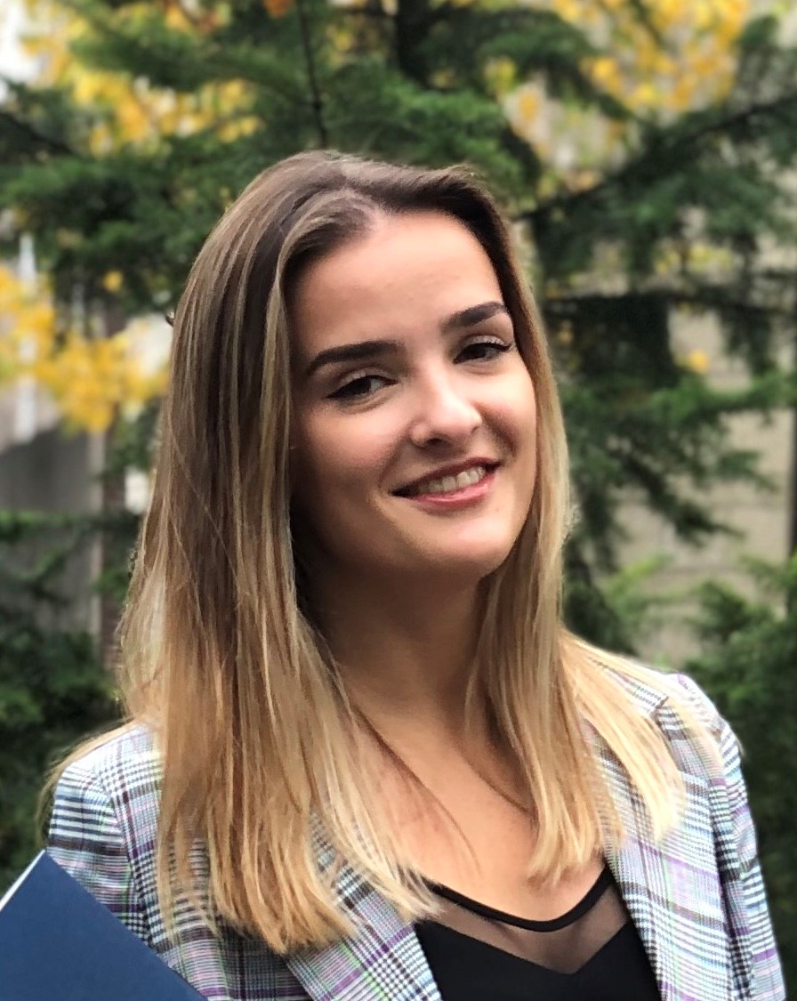
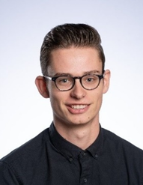
Teacher team
Instructor George Knox | Assistant Anne van der Vliet | Assistant Gijs van Bussel

Slide 6
2. Introduction Customer Analytics

Slide 7
Marketing: then and now
Product-centric
Transaction-focused
Customer-centric
Relationship-focused
Customers are assets that generate profits over time
Notes:
So why do you we teach you about customer analytics? Well, marketing used to be about selling more. Marketing used to be very product centered → How can we make more money out of the products that we have and should we raise the price or change the product in order to make more money or increase or profitability? In about 1990, or a little bit later, things started shifting → from earning more from a transaction to caring about your relationships with your customers (relationship focused). So instead of focusing on selling more, marketers started to focus on growing the relationships with their customers. So that he/she would not only buy something but would come back due to this good relationship with the company.
The idea is that customers are a type of asset that generates profit over time. So instead of thinking short term (how do I make money out of this transaction), you need a mindset that is more focused on → how do I grow my profitability of the customers lifetime with the firm.
That is essentially what changed and that has a lot of implications for what we do in terms of customer analytics.

Slide 8
Customer lifecycle
Customer development: change in behavior over time: buying more (up-selling) or different things (cross-selling)
Customer acquisition:
how customers are “born” or first contact with the firm.
Customer retention: preventing customer “death” or churn.
Marketing is about acquiring, developing and retaining customers
Notes:
One thing about that relationship is that it goes through different stages. You probably all know about the product lifecycle, however, in this course we talk about the customer lifecycle. When you think about a customer lifecycle you can think about these 3 very different stages. The first being acquisition. In this stage the customer is “born”, he/she makes his/her first contact with the firm. Then after that first period there is a phase that we call development. In this phase a customer may start buying different products from the company or may start buying more products from the company after that initial first contact. Finally, we have retention (customer death essentially).
So how do we prevent customers from leaving, from hitting this final stage or how can we extend the second period? That is what we will focus on in Customer Analytics. And from the perspective of the customer lifecycle, you can think of marketing as the process of acquiring, developing and retaining customers.
Product lifecycle → Introduction, Growth, Maturity, Decline

Slide 9
Customer analytics
Using customer data and statistical models to make business decisions:
Who should be targeted for … a marketing campaign, churn prevention, cross-selling, acquisition?
Should we do a test before we roll it out? How big?
How many subscriptions/transactions can we predict over time for a cohort of customers?
How valuable is a customer to the firm over his or her lifecycle? How does it differ across customers?
Notes:
So, let’s make it a bit more concrete. What is customer analytics → it is using customer data, in statistical models, to make business decisions. That is still a very broad definition, so let’s make it a bit more specific by going over the different components of customer analytics that we will cover in this course).
First, a lot of marketing decisions are about who to target, for example for a marketing campaign or for a churn prevention program (for example, you as KPN are worried that your customers might leave after their current subscription period is over so you might provide these customers a discount on their next phone. This is an example of a churn prevention program, so who should we target for that?). Similarly, who should we target to cross sell? Etc. So there are statistical models that we can fit to these stuff so that we can make better predictions about these kind of questions.
In the second part of this lecture you will watch web clips about testing (which is the second component of customer analytics). Here we will focus on testing, for example a marketing campaign, in order to check whether this campaign should be rolled out. To check whether it will be a success.
Third, we will talk about the number of subscriptions/transactions over time and how we can predict these based on data. So for a bunch or cohort of customers, who have already purchased a certain amount of times, how much can we expect over their lifetime.
And lastly, we will talk about lifetime value. So how valuable is a customer over his/her lifecycle and how different is that (do all your customers have roughly the same lifetime value or is this very different; do you have vary valuable customers and customers who aren’t that valuable, or who are not valuable at all?).

Slide 10
3. General course information

Slide 11
Course components
Q&A session In the next week
Lecture
Computer lab
Everything will be given online; no in-person/offline sessions
Everything will be given live and recorded
Notes:
Anne Q&Q

Slide 12
Lectures 1-5: Short-term analytics
Testing and Uncertainty: Why test? Quantifying uncertainty; how large should the test be?
Models for selecting customer to target: which customers should be selected for e.g., acquisition, retention, direct mailing?
Models for customer development: collaborative filtering, cross-selling
Notes:
Broadly speaking, we can divide this course up into two sections.
The first part is about short term analytics, so what happens next. We will fit a model to check whether a customer will respond or not/engages in some sort of behavior. And based on that next period model, we make our decision of whether to target or not.
So, broadly speaking, you can see these topics of acquisition, retention, direct mailing, as short term analytics (predicting what customers will do and as a result of something in order to make good targeting decisions).

Slide 13
Lectures 6-7: Long term analytics
How does the customer base change over time as customers drop out? Why does retention increase over time?
Customer lifetime value (CLV): who are the most valuable customers: how do you calculate the value to the firm of the customer over his or her lifecycle?
Notes:
In the second part of the course, we will focus on long term analytics.
So we just talked about these relationships firms have with their customers over a longer period of time. So how do we model that? Not just that happens in the next period, but over the lifetime of the customer. And the major thing we will look at is customer lifetime value.

Slide 14




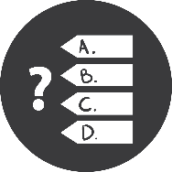

Structure lectures and lab sessions
Kick-off (+/- 5 min)
Webclip 1
Webclip 2
Q&A (+/- 15/20 min)
Study
Quiz (self-test)
Send in questions
Lecture
After the lecture (own time)
Individual: watch the webclips and send in questions via email (+/- 60/70 min)

Slide 15
Grading
Individual assignments: 30%
Computer exam (individual): 70%
To pass the course you need:
final grade ≥ 6
exam grade ≥ 5
The assignment grade still counts if you take the resit
Notes:
7 Individual assignments in Canvas → together 30% of your course grade → No Resit
Computer exam (likely on Campus on a Campus computer) in TestVision → 70% of your Grade → Resit

Slide 16
Assignments
Each module has an assignment
Opens up after the lecture of that week, deadline before the next lecture
Late assignments not accepted
It’s OK if you discuss with others, but all assignments are to be done individually.
Canvas Assignment
Notes:
Next lecture = Thursday September 4
Assignment 1: Uncertainty

Slide 17
Data sets & software
The course is organized around several data sets that illustrate an important concept.
All these examples will be “hands-on” and have an emphasis on real-time problem solving.
We’re using R (4.1.1. “Kick Things”)
Advantages: widely used & lots of contributed software, free
Disadvantages: programming language, unpredictability of packages, updates
R notebooks in the computer lab
Notes:
Canvas → Introduction to R and how to download R

Slide 18
Readings
Book: Blattberg, Robert C., Byung-Do Kim, and Scott A. Neslin. Why Database Marketing? Springer New York, 2008. [BKN]
Articles: Other articles and material you can find on canvas under modules.

Slide 19
Contact
Consult the FAQ page on Canvas;
Check the Announcements on Canvas;
If you send us an e-mail (after following steps 1-2 above), please always send it to customeranalytics@tilburguniversity.edu.
Do not send e-mails to the instructors’ personal Tilburg University e-mail addresses (these e-mails will not be answered).

Slide 20
Questions?

Slide 21
4. Web clips Module 1

